Slide 1
Android Heart Disease Prediction using Random Forest
Presented By :
[Student’s Name Here]
[Student’s Name Here]

Slide 2
INDEX
Project Overview
Scope
Modules
Development Tools
Pros & Cons
Applications

Slide 3
PROJECT OVERVIEW
It might have happened so many times that you or someone yours need doctors help immediately, but they are not available due to some reason.
The Heart Disease Prediction application is an end user support and online consultation project.
Here, we propose an android application that allows users to get instant guidance on their heart disease through an intelligent system online.
The application is fed with various details and the heart disease associated with those details.
The application allows user to share their heart related issues.
It then processes user specific details to check for various illness that could be associated with it.
Here we use some intelligent data mining techniques to guess the most accurate illness that could be associated with patient’s details.
We use Random Forest Classifier to predict the illness with the help of multiple health parameters.
Based on result, system automatically shows the result specific doctor’s for further treatment.
The system allows user to view doctor’s details.
The system can be use in case of emergency.

Slide 4
SCOPE
The main objective of this research is to develop a heart prediction system. The system can discover and extract hidden knowledge associated with diseases from a historical heart data set Heart disease prediction system aims to exploit data mining techniques on medical data set to assist in the prediction of the heart diseases.

Slide 5
MODULES
ADMIN
Add Training Data
Add Doctor Details
View User Details
View Feedback
View Doc Details
View Training Data
USER
Register
Login
Check Heart
View Doctor
Write Feedback

Slide 6

DEVELOPMENT TOOLS
ANDROID STUDIO
Android Studio is the official[7] integrated development environment (IDE) for Google's Android operating system, built on JetBrains' IntelliJ IDEA software and designed specifically for Android development.
Features:
1. Rich Layout Editor
2. Android Virtual Device
3. Quick Fixes Suggestion

Slide 7
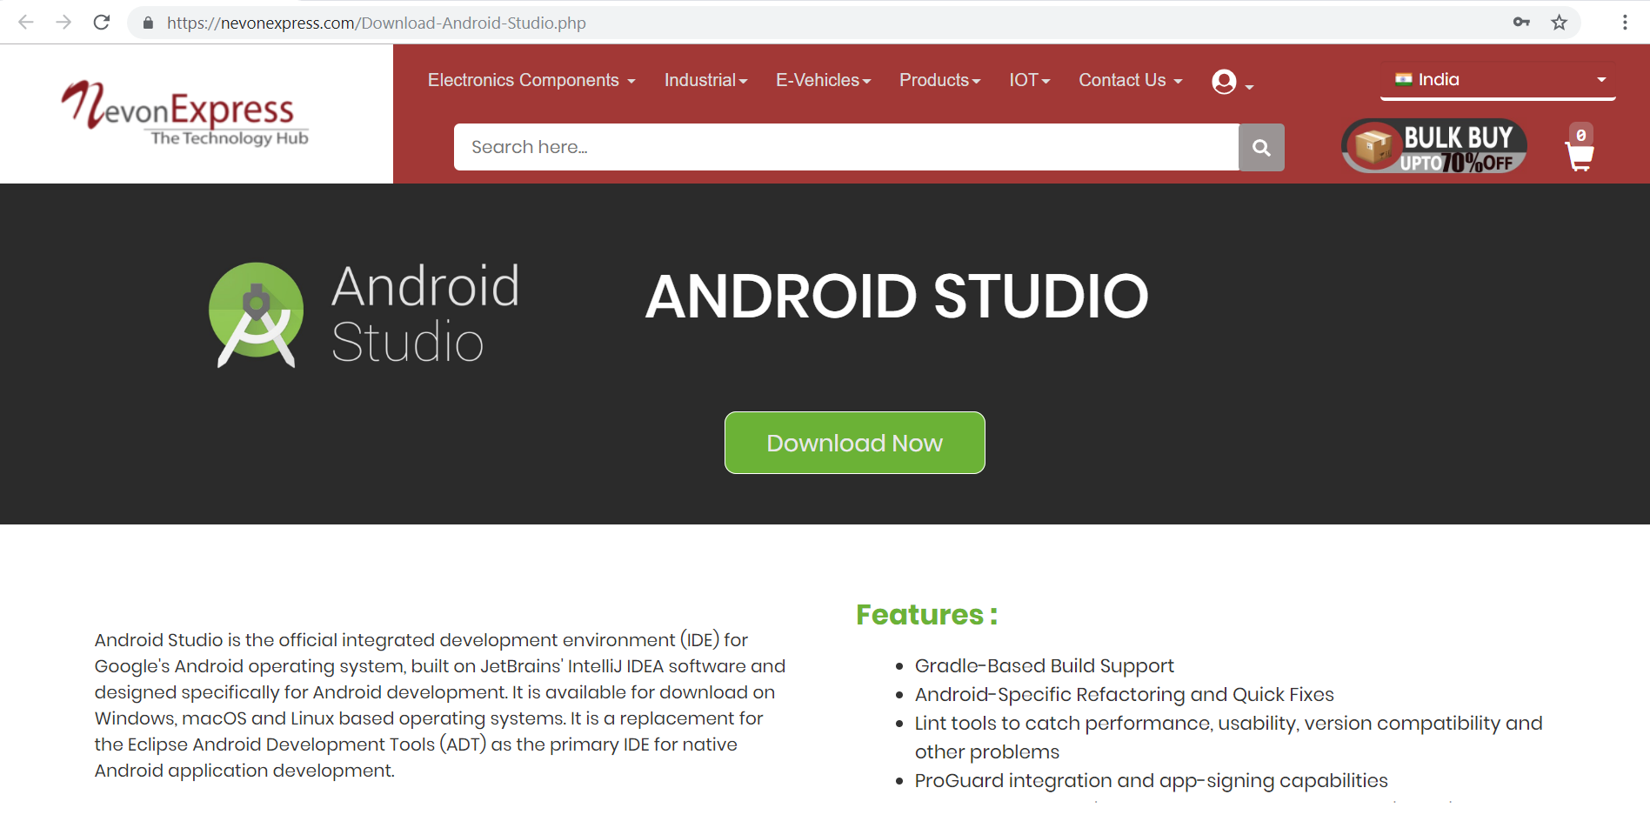
Download Android Studio
We can get Android Studio from NevonExpress.com : Visit Here

Slide 8
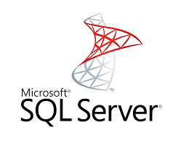
DEVELOPMENT TOOLS
MICROSOFT SQL SERVER
Microsoft SQL Server is a relational database management system developed by Microsoft. As a database server, it is a software product with the primary function of storing and retrieving data as requested by other. Microsoft markets at least a dozen different editions of Microsoft SQL Server, aimed at different audiences and for workloads.
Features:
1. Least Vulnerable 2. Advanced Analytics 3. Easy-to-Use

Slide 9
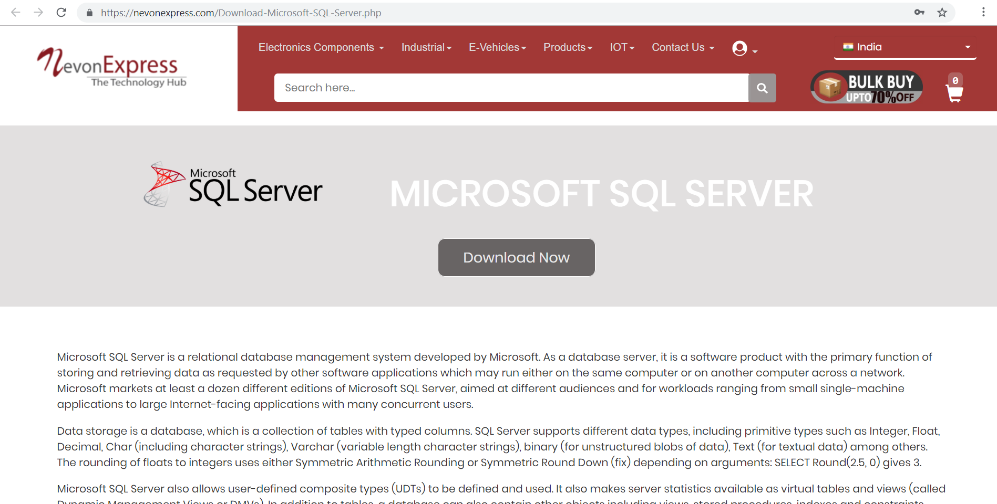
Download Microsoft SQL Server
We can get SQL Server from NevonExpress.com : Visit Here

Slide 10
PROS & CONS
Pros
User can search for doctor’s help at any point of time.
User can talk about their Heart Disease and get instant diagnosis.
Doctors get more clients online.
Random forest is one of the most accurate classifier algorithms among decision tree.
Very useful in case of emergency.
Cons
The system is not fully automated, it needs data from user for full diagnosis.
User need to put correct data or else it behaves abnormally.

Slide 11
APPLICATIONS
This application can be used by all patients or their family members who need help in emergency.

Slide 12
THANK YOU !!!

